Slide 1

Exercise Sets, Faculty Commons, and Resources of the PICUP Website
Todd Zimmerman
University of Wisconsin – Stout
Summer AAPT Meeting
July 12, 2022
Notes:
Abstract: “Over the past several years, the Partnership for Integrating Computation into Undergraduate Physics (PICUP) has curated a collection of materials to help instructors add in computational modeling to their courses. I’ll discuss the various resources and how you can contribute to the community.”
Todd Zimmerman
Editor-in-Chief of the PICUP Collection
My goal in this talk is to give some perspective of how far we’ve come in integration computational modeling into the physics curriculum and to point out directions we might go.
PICUP focus

Slide 2

Mission of PICUP
Lower the barriers to integrating computation into classes
Community
Training
Resources
Notes:
Just a little about me:
My undergrad was a a little place called Lawrence University and I was the second class to reap the benefits of a brand new computational physics suite created by David Cook. I grew up thinking computation was just something that was part of the curriculum.
It wasn’t until I started teaching and people would look at my like I was crazy for trying to do computation that I realized this wasn’t the norm.
It was a Global Physics Department meeting in 2016 where I first heard about PICUP and I had already applied for the first FDW before I had finished listening to the talk.
When I got to the FDW I realized I had found someplace where I belonged, where people saw not just the potential but the fundamental need to include computation in the undergraduate curriculum.
Over the past several years I’ve had a ring-side seat to watch the PICUP community grow in the number of people involved as well as in the resources we have available to help lower the barrier to adding computation
Mission
Focus on resources

Slide 3
Computation in Physics - Definition
Having students work with simulations and/or algorithms, giving students pieces of code to complete on their own, and/or advising students on undergraduate research projects where they write code from scratch¹
1. Caballero, Marcos D., and Laura Merner. "Prevalence and nature of computational instruction in undergraduate physics programs across the United States." Physical Review Physics Education Research 14.2 (2018): 020129.
Notes:
My thought is if your hands are on the keyboard, mouse, or touch screen and you are trying to understand physics at that time, it’s computation.

Slide 4
A Brief History
2006 – Shodor Visioning Workshop – PICUP is born
2006 - Special issue on computation in physics in Computing in Science and Engineering
Fuller – “Numerical Computations in US Undergraduate Physics Courses”¹
2008 – “Integrating computation into the undergraduate curriculum: A vision and guidelines for future developments”²
AJP article by Chonacky and Winch
2011-2013 – Development workshops
2013 – Present Workshops at various conferences
2015 – Two NSF proposals for PICUP funded
M.D. Caballero, K. Roos, L. Engelhardt, M. Lopez, R. Hilborn, N. Chonacky
2016 - First Faculty Development Workshop
gopicup.org
2018 – “On the Prevalence and Nature of Computational Instruction in Undergraduate Physics Programs across the United States”³
2020 First virtual workshop
1) https://bit.ly/3bTaccd 2) https://bit.ly/3IDOqWt. 3) https://bit.ly/3ao2y9v
Notes:
As a result of an AAPT cracker-barrel, David Winch and Norman Chonacky (along with many others) started to plot a campaign to infuse computation into undergraduate physics.
During a 2006 workshop funding by the Shodor Education Foundation, PICUP was born
Norman Chonacky and David Winch put together a special issue of Computing in Science and Engineering on the use of computation in physics
They worked with Robert Fuller to survey faculty on their beliefs and useage of computation
In an article by Winch and Chonacky in AJP they put forth recommendations for the physics community
Two development workshops and a FDW pilot workshop held between 2011 and 2013
Two NSF grants funded in 2015, which led to first FDW
A 2018 paper by Danny Caballero and Laura Merner provides a more current view on the state of things so far.

Slide 5

Numerical Computations in US Undergraduate Physics Courses¹
Survey for faculty on importance and use of computation (N=187)
Large fraction thought computation important
<20% included computation in grades
1) Fuller, Robert G. "Numerical computations in US undergraduate physics courses." Computing in science & engineering 8.5 (2006): 16-21.
Article: https://bit.ly/3NXs8j7
Notes:
Norman Chonacky, David Winch, and Robert Fuller sent out a survey exploring how important faculty thought computation was in the physics curriculum and how it was used
135 out of roughly 900 faculty responded to the survey.
This paper (and the issue) helped continue a conversation that had started as a ”heated discussion” at the previous Salt Lake City AAPT meeting.

Slide 6

On the Prevalence and Nature of Computational Instruction in Undergraduate Physics Programs across the United States¹
Response: 357 departments and 1246 faculty
>50% of departments have 1 faculty teaching computation in intro and upper level courses
>25% of departments have ½ of faculty teaching computation in intro and upper level courses
1. Caballero, Marcos D., and Laura Merner. "Prevalence and nature of computational instruction in undergraduate physics programs across the United States." Physical Review Physics Education Research 14.2 (2018): 020129.
Article: https://bit.ly/3ao2y9v
Notes:
Did find a growth in expertise from Chonacky and Winch but didn’t translate to as large a growth in the classroom.
There is follow-up research on the barriers by Leary, Irving and Caballero in the 2018 PERC proceedings

Slide 7
PICUP
Website:
Exercise Sets
Faculty Commons
Resources Tab
Community and Events
Training:
Regional Workshops
Virtual Workshops
Site Visits
Webinars
Community
Webinars and Workshops
Slack Channel

Slide 8
PICUP
Website:
Exercise Sets
Peer-reviewed activities
Faculty Commons
All other curricular material
Resources Tab
Tips and best practices
Community and Events
Stay connected, get help

Slide 9
Exercise Sets (ES)
An Exercise Set is a set of peer-reviewed material that contains the following:
A brief description of the set and it’s goals
A list of learning objectives for the set
An instructor’s guide and theory section for background
A series of activities and questions (the exercises)
Code template and solutions in at least one programming language
Solutions
All Exercise Sets are peer-reviewed through semi-automated process
Collaborative peer-review

Slide 10
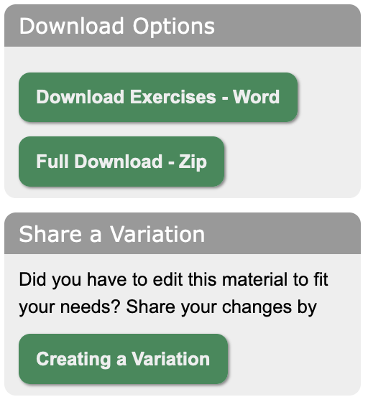
Why are ES special?
Complete package
Easy to download and modify
Can upload variants
Language agnostic
Templates and solutions available in one or more platforms
Peer-reviewed

Slide 11
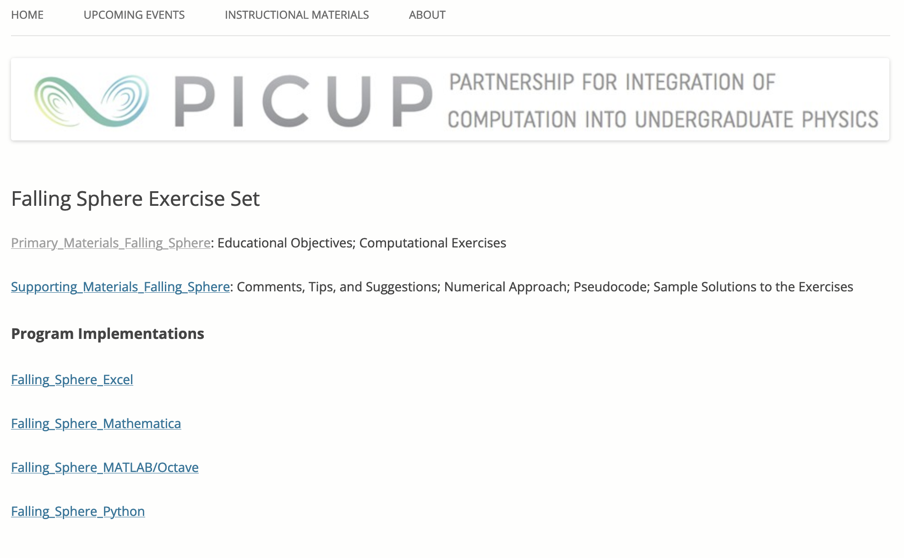
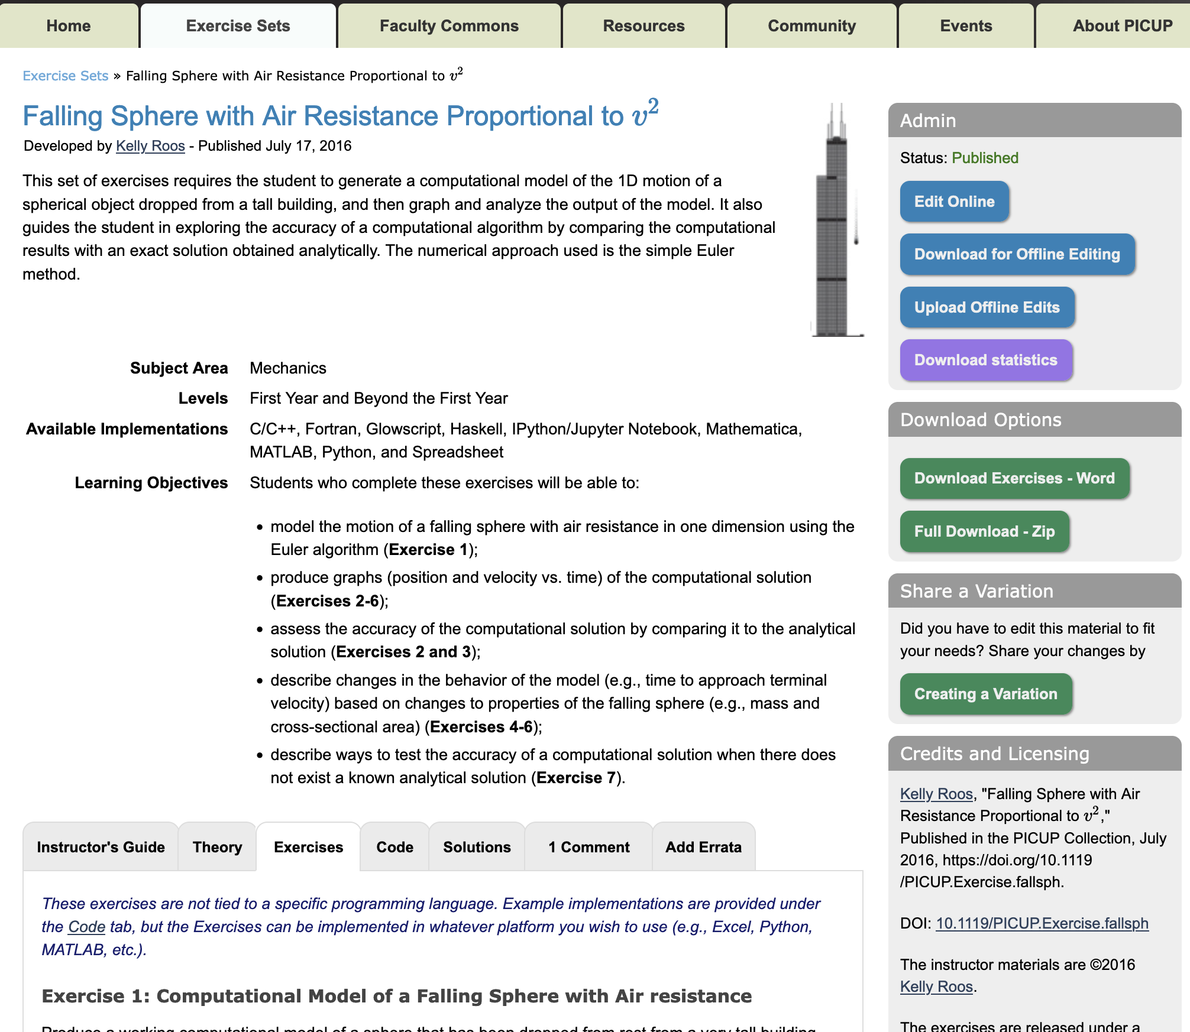
Then and Now
Notes:
Although many of you are familiar with the website, I want to go over it in a little detail because we are always adding new features that people might not be aware of, and also I’d like to highlight a lot of the work that Lyle Barbato, Kelly Roos, and Larry Engelhardt have put into making this an invaluable resource
GO through basic features

Slide 12
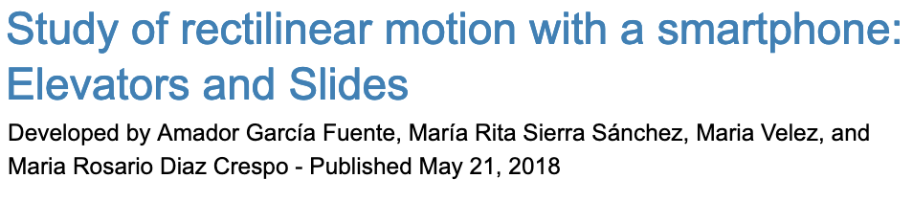

Multiple authors, non-faculty authors
Exercise sets can now have multiple authors
Students can be included as authors
Select “Non-Faculty Verification” on Registration page

Slide 13
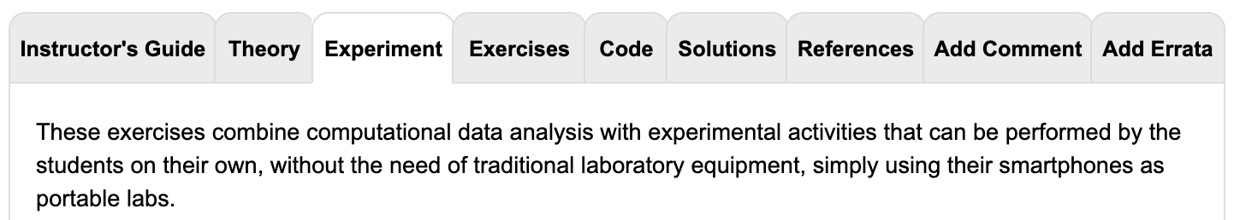
Experiments
Exercise sets can combine experiments with computation
Notes:
ADD SEARCH FEATURE

Slide 14
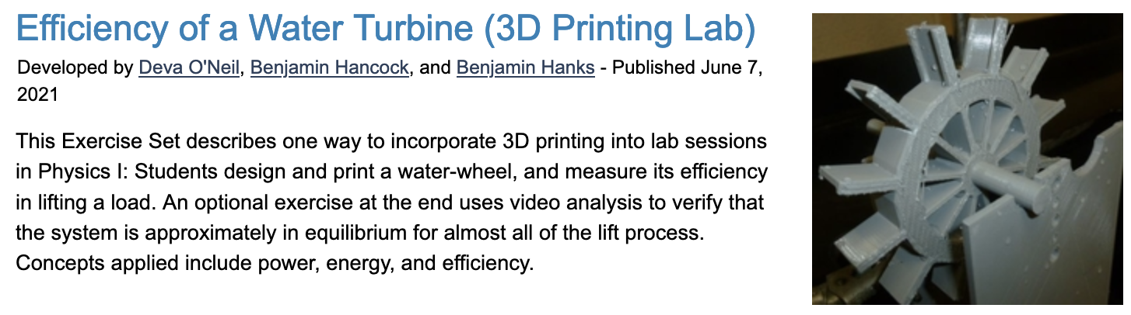
3D Printing
Can find 3D files under Additional Resources on the Code tab

Slide 15

Errata Tab
You can point out errors in ES

Slide 16

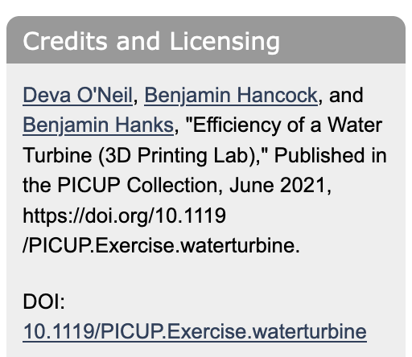
Digital Object Identifier (DOI)
All ES now have DOI’s

Slide 17
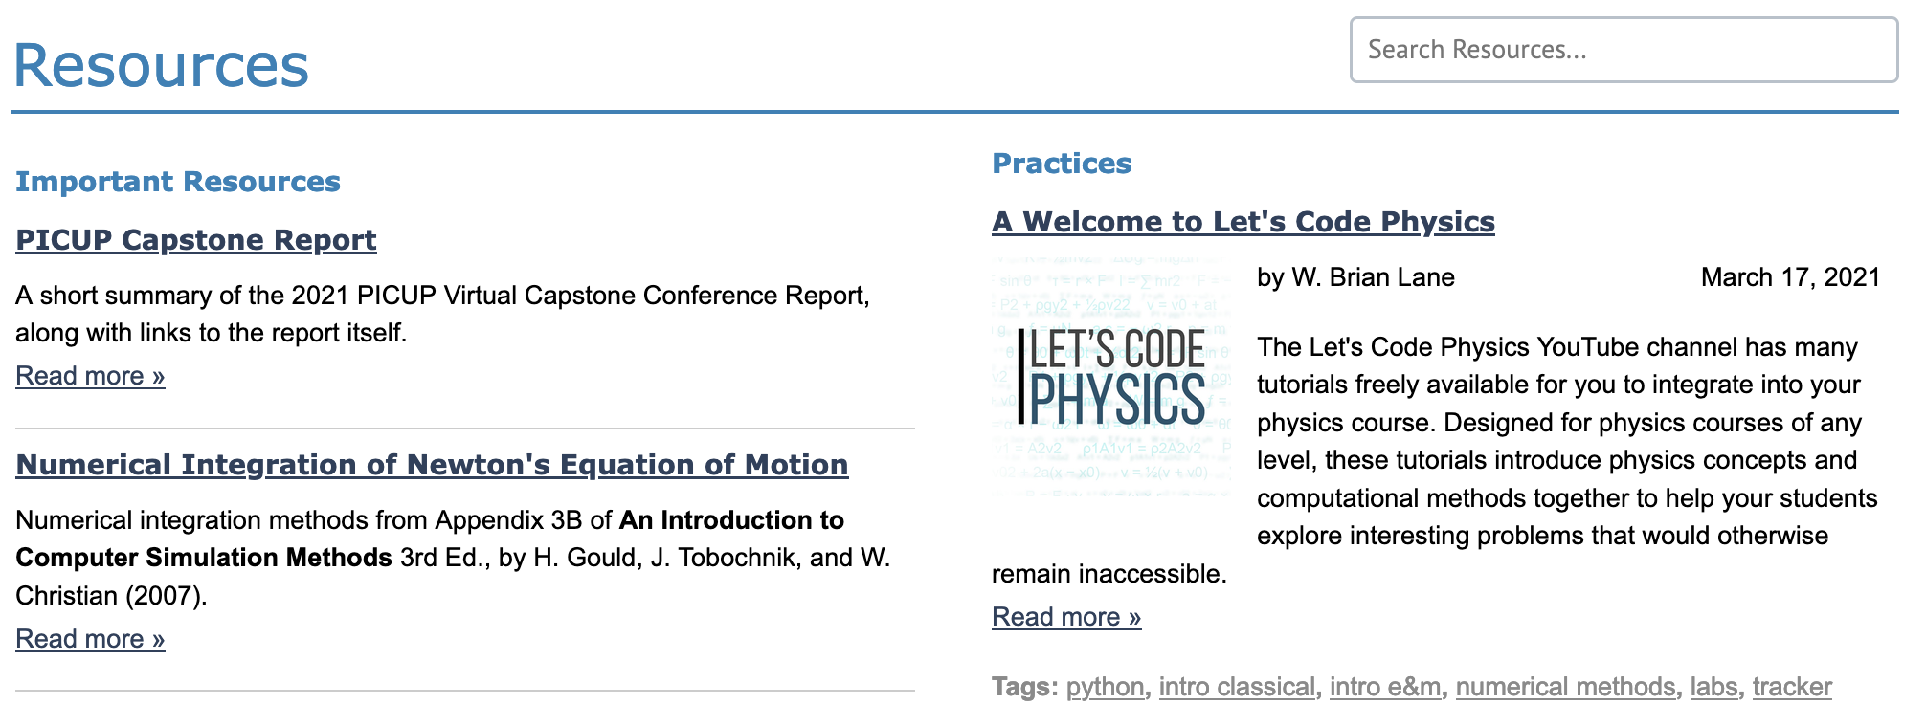
Resources Tab
Important Resources
Practices

Slide 18
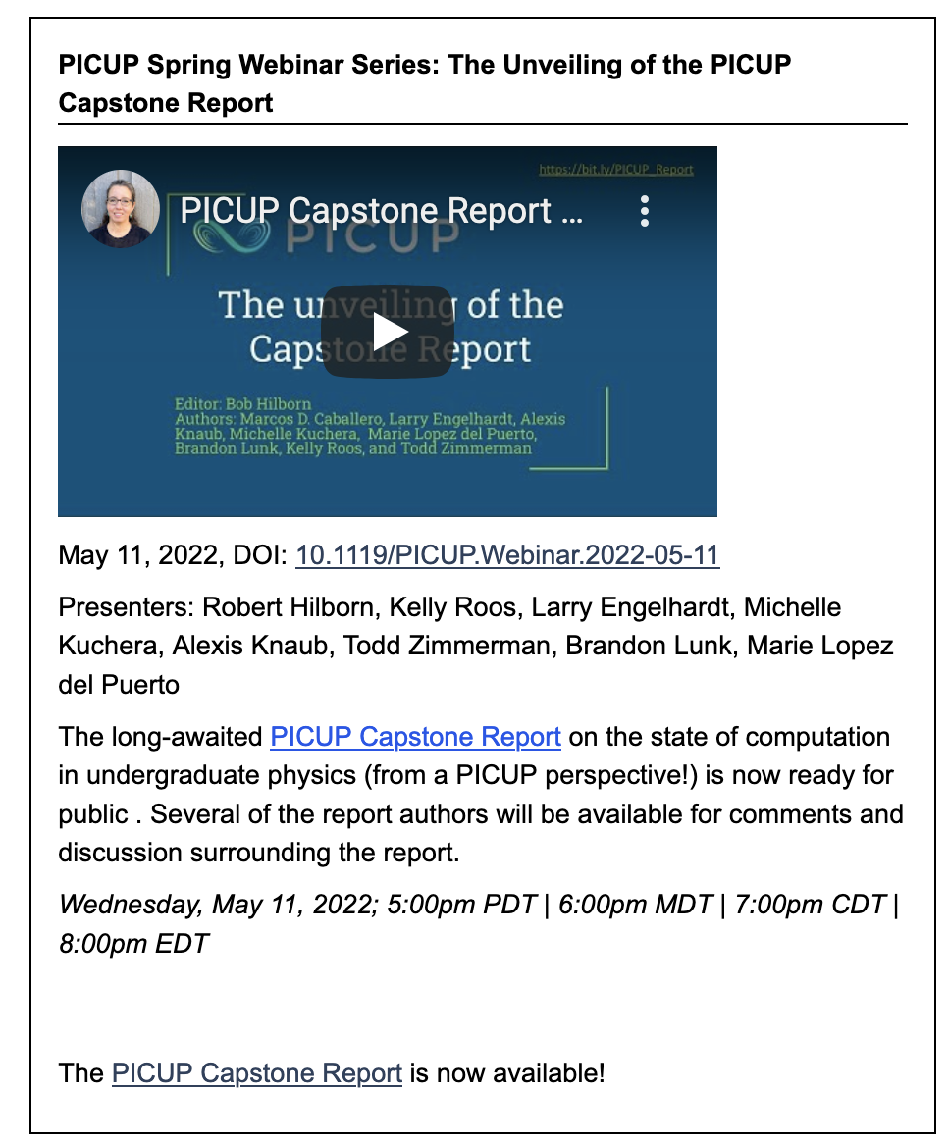
Community Tab
Collection of previous PICUP Webinar Series
Now include DOIs

Slide 19

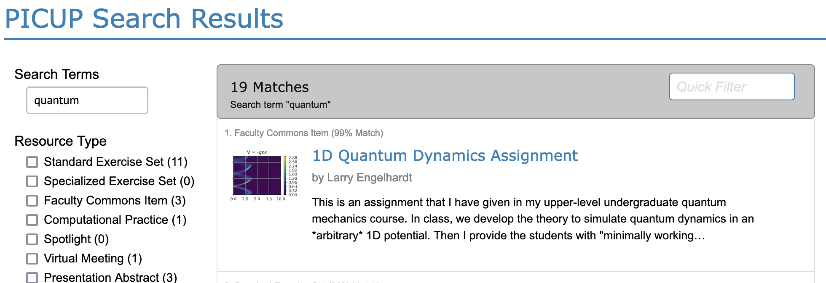
Site-Wide Searching
You can search:
Exercise Sets
Faculty Commons
Resources
Webinar abstracts
Conference abstracts

Slide 20
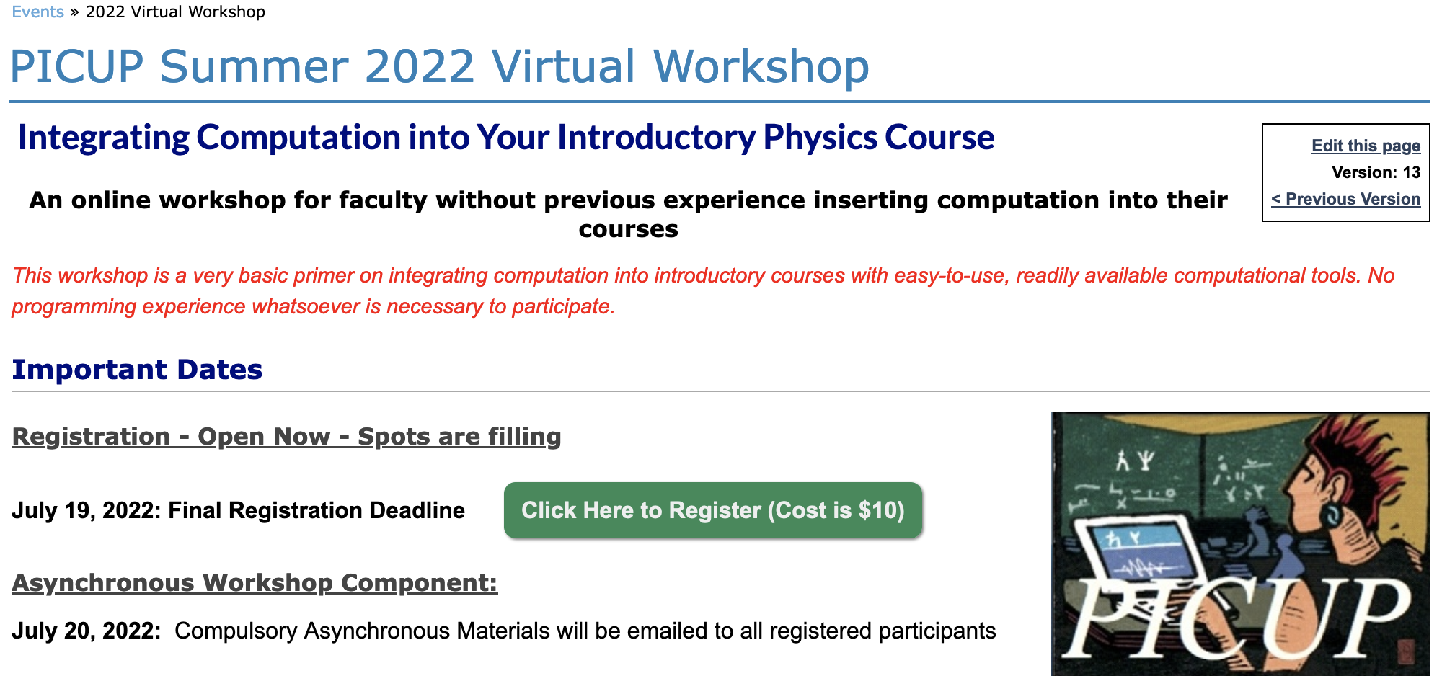
Training
Virtual Workshops
Aug 2-4
Sign up by July 19
Notes:
Currently working on a grant submission. Hope to have in-person workshops in the not too distant future.

Slide 21
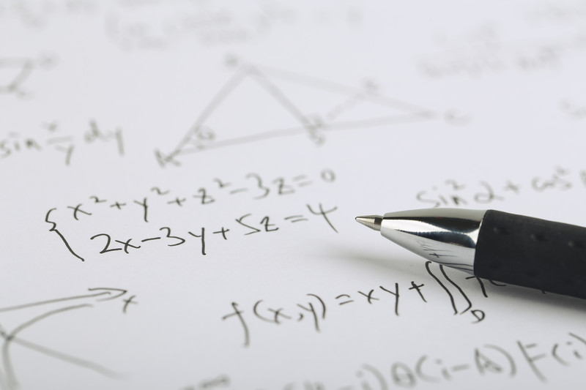
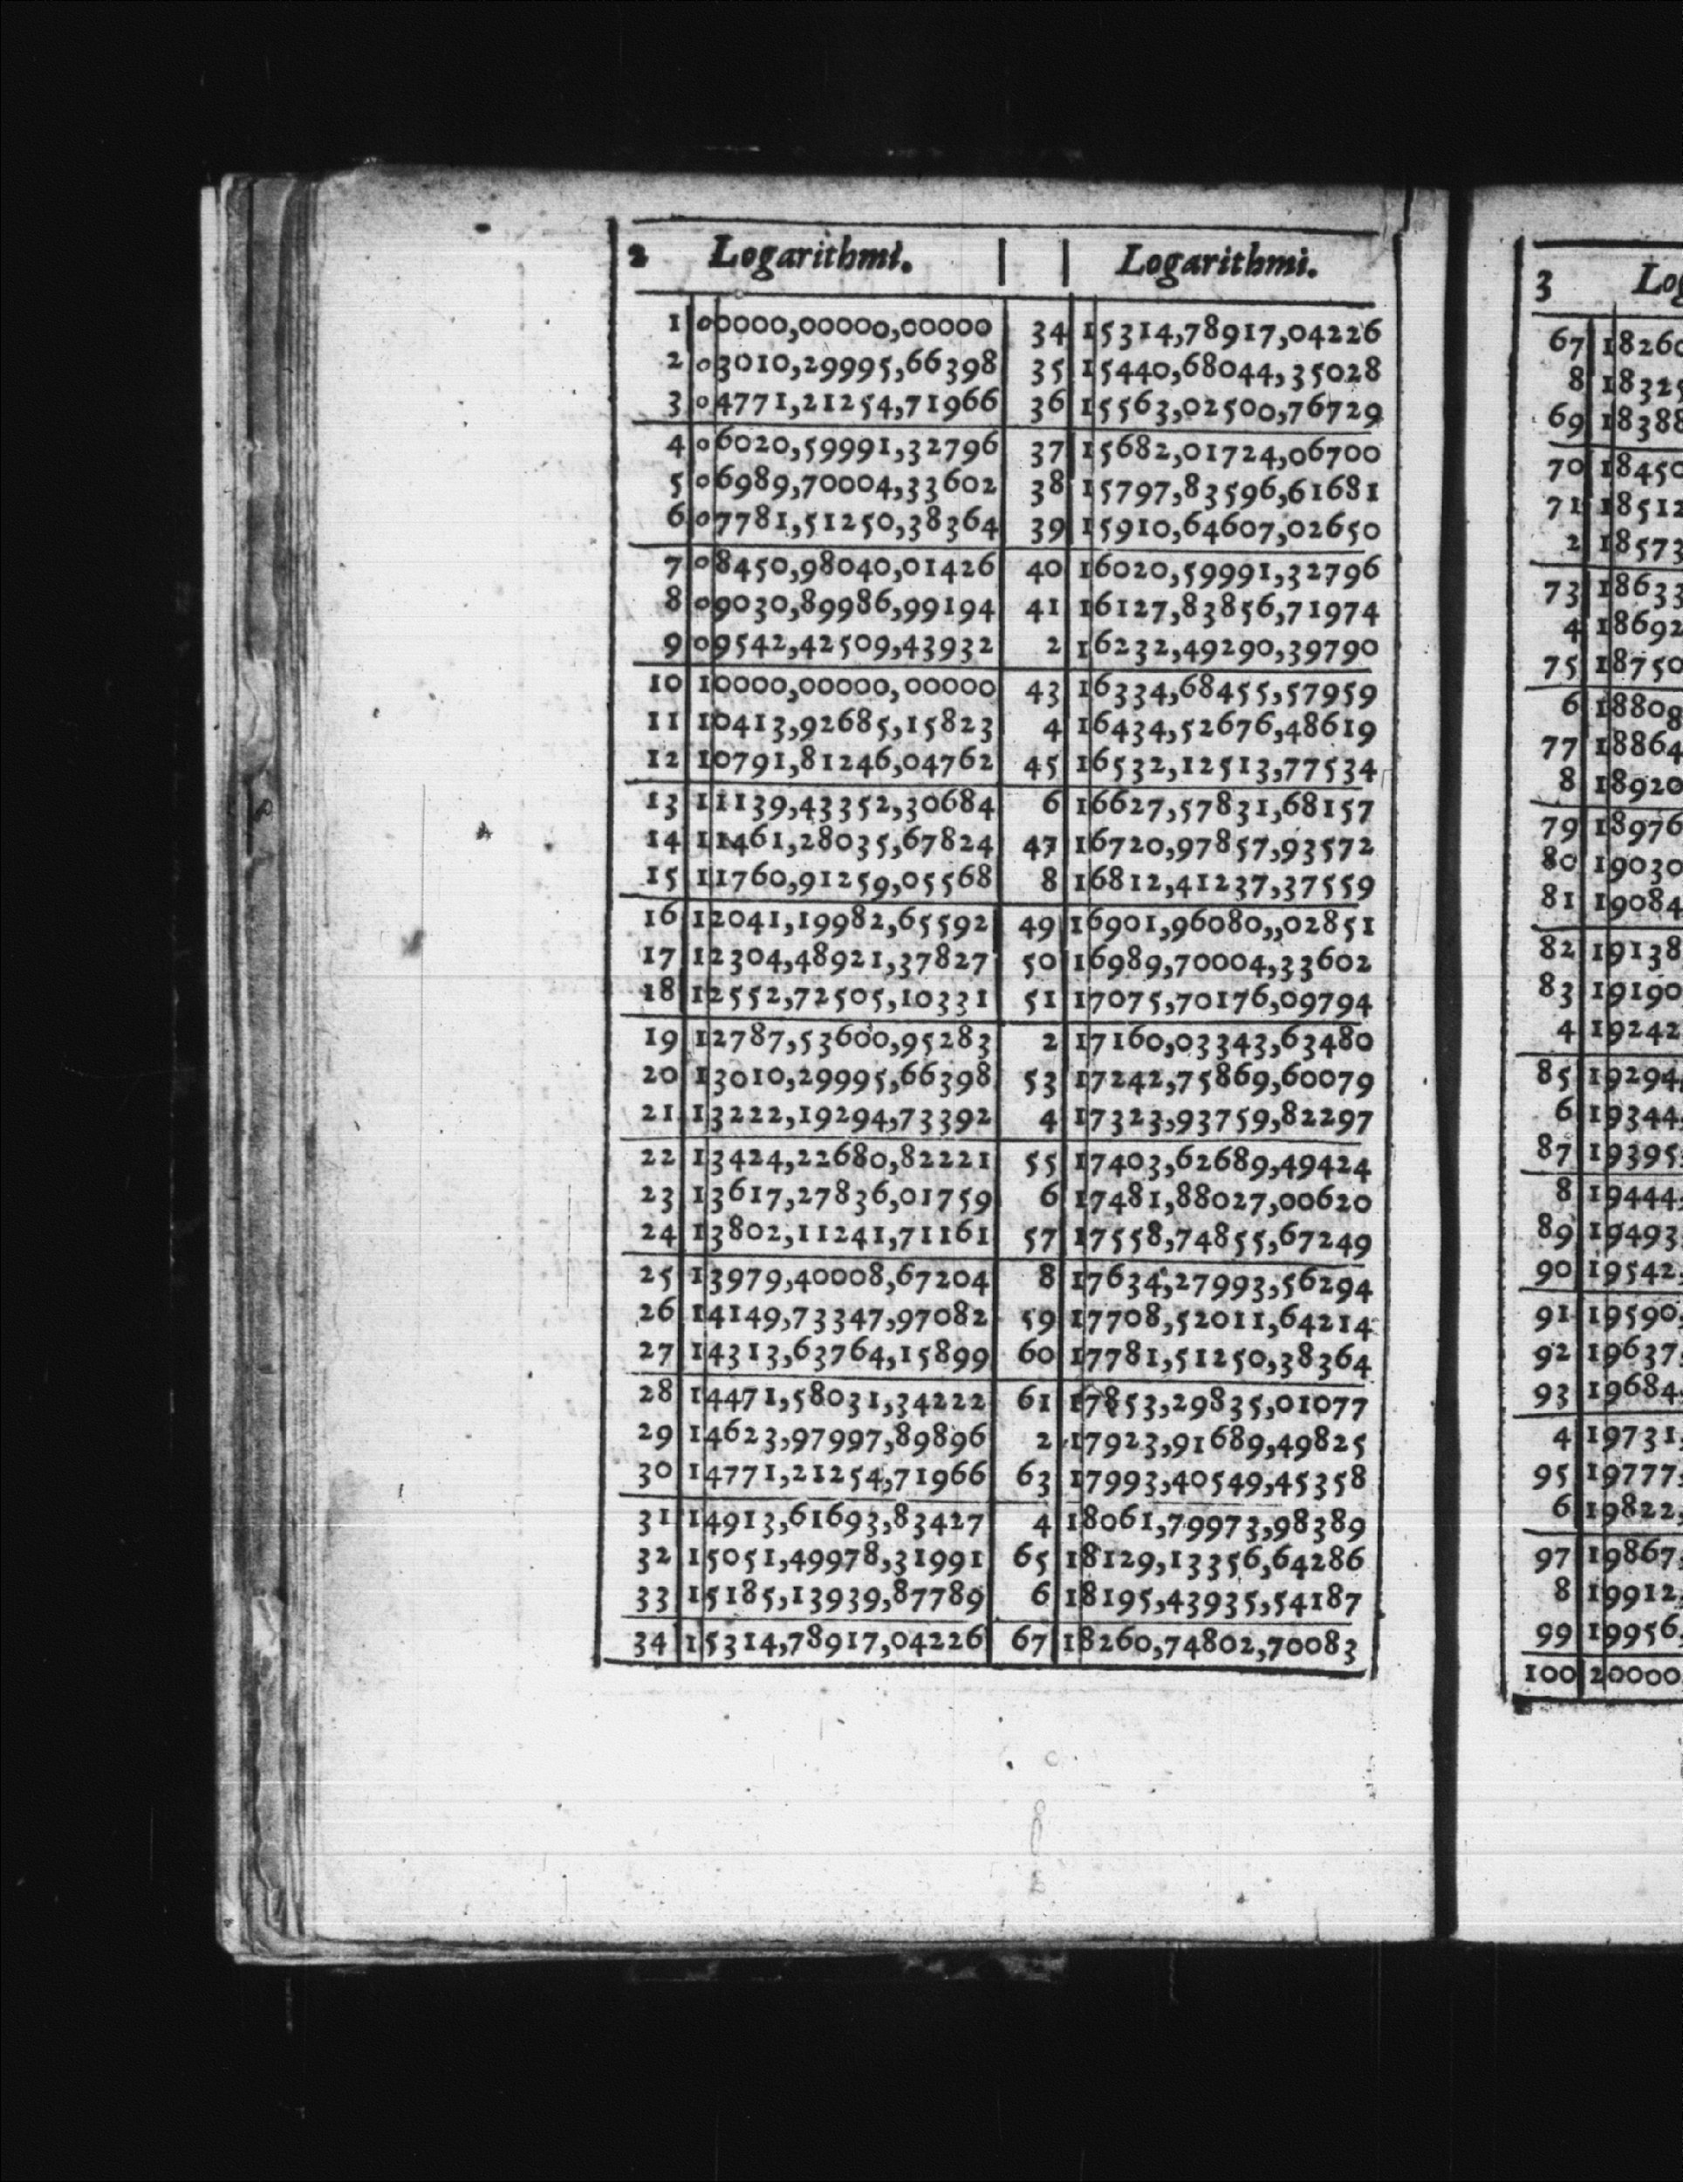
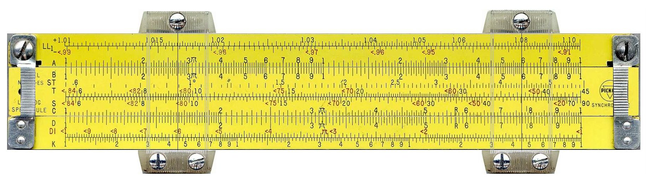
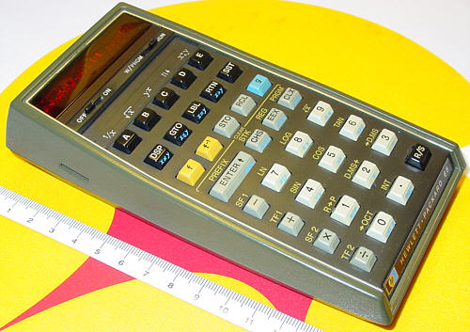
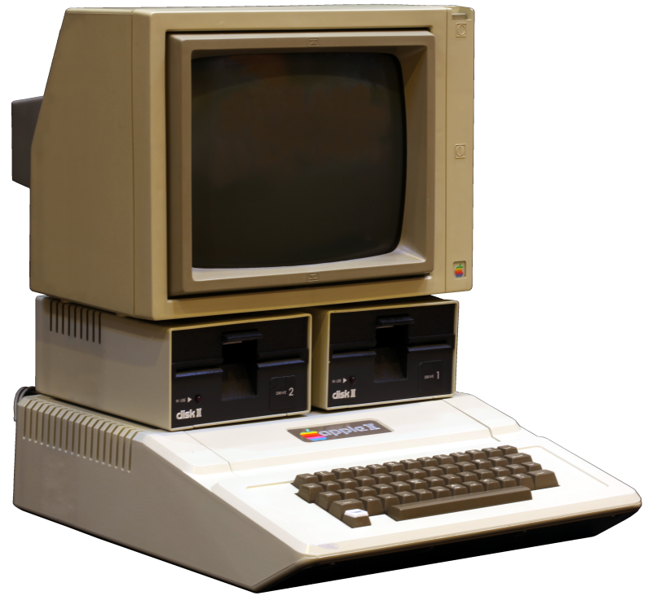
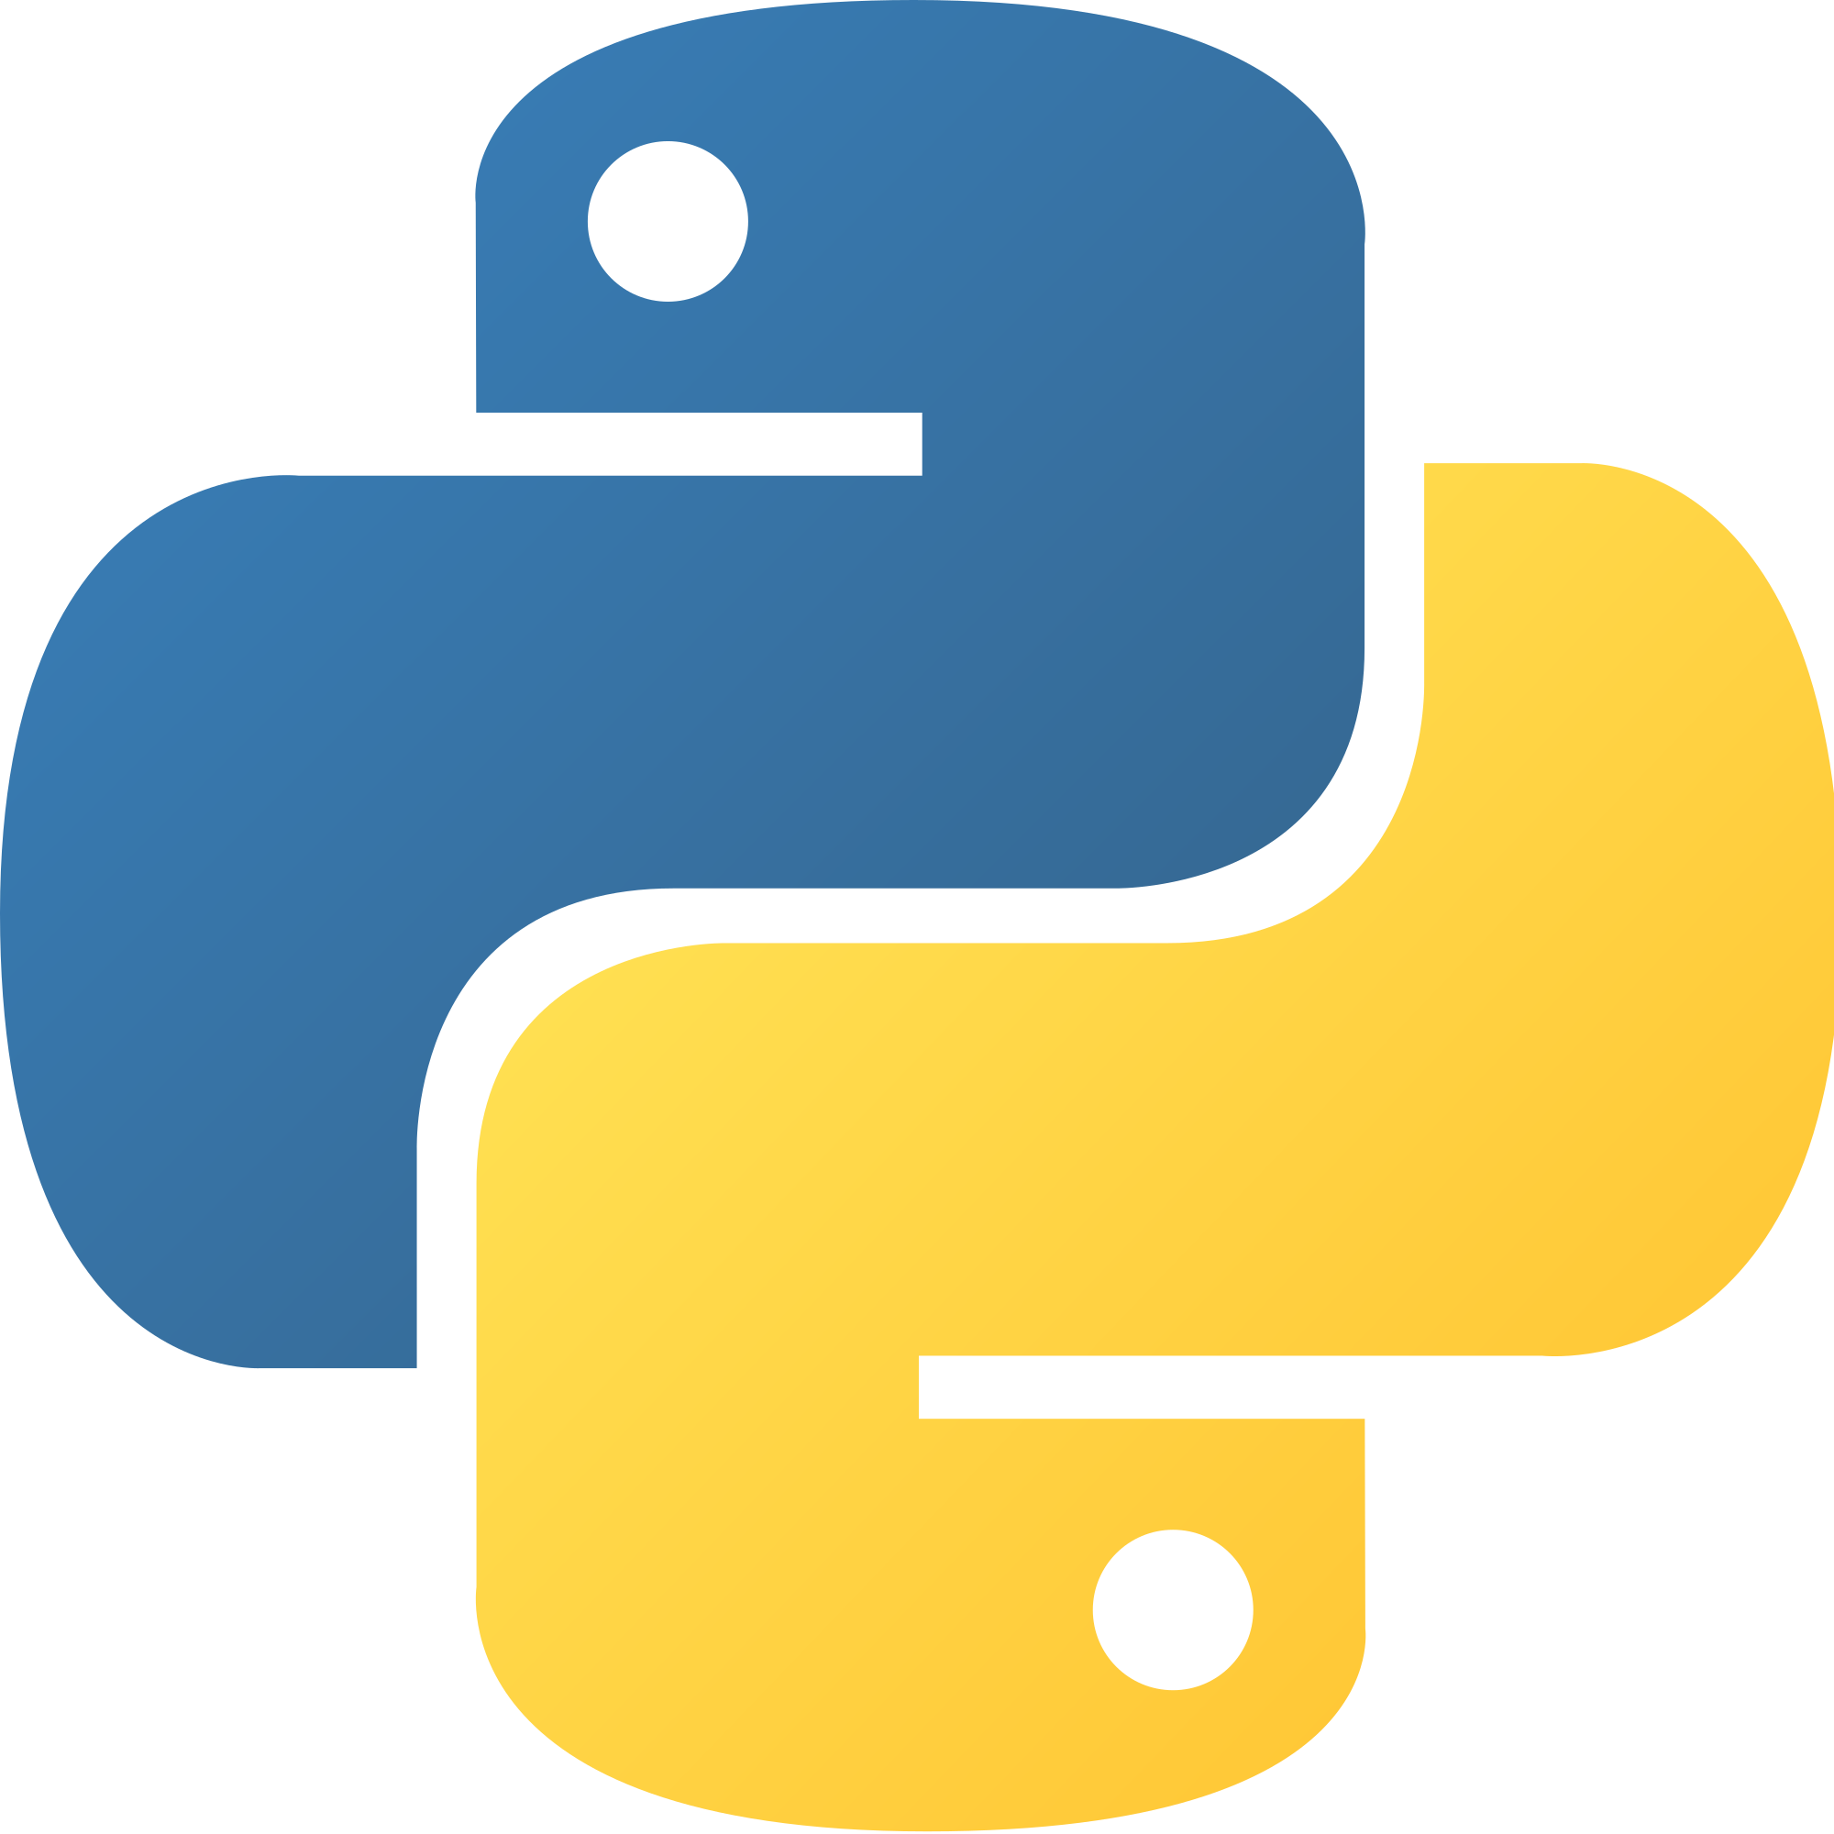
A Short History of Computation
Hand-written math: ~ 3000 BCE - …
Logarithm Tables: 1614 to ?
Slide Rules: 1620 to 1975
Handheld Calculator: 1972 - …
Personal Computer: 1977 – …
Python: 1989 - …
Notes:
Log Table: By Henry Briggs - http://www.pmonta.com/tables/logarithmorum-chilias-prima/index.html, Public Domain, https://commons.wikimedia.org/w/index.php?curid=43431356
Slide rule: By teclasorg - Flickr, CC BY-SA 2.0, https://commons.wikimedia.org/w/index.php?curid=1173203
Calculator: By Rama, CC BY-SA 2.0 fr, https://commons.wikimedia.org/w/index.php?curid=29591429
Python Logo: www.python.org [GPL (http://www.gnu.org/licenses/gpl.html)]
At what point will the benefits of computation outweight the benefits of analytical solutions?
Don’t think we are there but need to have conversation now

Slide 22
Thank You
Resource Development: Lyle Barbato, Kelly Roos, Larry Engelhardt
Other PICUP Leadership: Marie Lopez del Puerto, Danny Caballero, Robert Hilborn, and Norman Chonacky
Evaluator: Alexis Knaub
PICUP Associate Editors and Reviewers
You, the PICUP community
Thank you to the UW-Stout Chancellor, STEMM Dean, and Department of Chemistry and Physics Chair for funding

